Slide 1
Chapter 3 Underlying Technologies

Slide 2
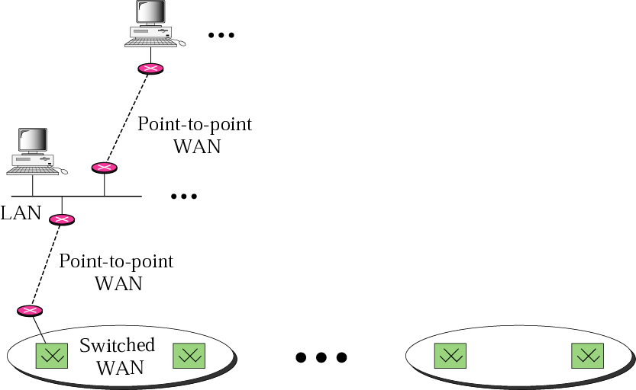
Internet Model
Internet is a set of switched WANs (backbones), LANs, point-to-point WANs, and connecting or switching devices

Slide 3
Outline
Wired Local Area Networks
Wireless LANs
Point-to-Point WANs
Switch WANs
Connecting Devices

Slide 4
Local Area Network (LAN)
In a limited geographic area
A department, a building, or a campus
Popular LANs
Ethernet LANs
Token Ring LANs
Token Bus LANs
FDDI
ATM LANs

Slide 5
IEEE Standards
IEEE Project 802
Specify functions of the physical layer and the data link layer of major LAN protocols
Relationship of the 802 standard to OSI model
IEEE subdivide the data link layer into two sublayers
Logical Link Control (LLC)
Media Access Control (MAC)

Slide 6
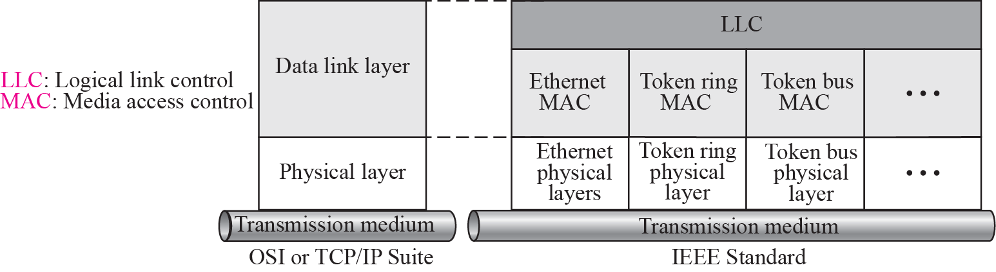
Figure 3-3
IEEE Standards for LANs
The McGraw-Hill Companies, Inc., 2000

Slide 7
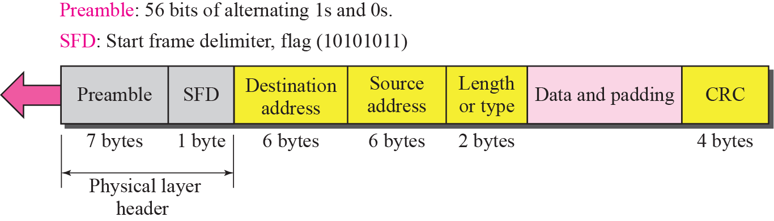
Frame Format
Ethernet specifies only one frame type containing seven fields
Ethernet is an unreliable medium
Does not provide acknowledgement mechanism

Slide 8
Frame Format (Cont.)
Preamble
7 bytes of alternating 1s and 0s
Added at the physical layer for synchronization
Start frame delimiter
1 bytes: 10101011, the last chance to synchronize
The last 11 signals that the next field is the address
Destination address: 6 bytes
Physical address of the intermediate or the destination station
Source address: 6 bytes
Physical address of the sending or intermediate station

Slide 9
Frame Format (Cont.)
Length/type: has one of two meaning
< 1518: length: the length of the data field
RFC 1042:
> 1536: type: define the upper layer protocol
RFC 894:
0800: IP
0806: ARP
8035: RARP
Data: 46~1500 bytes
Padding is needed if upper layer packet is less than 46 bytes
CRC: CRC-32 for error detection

Slide 10
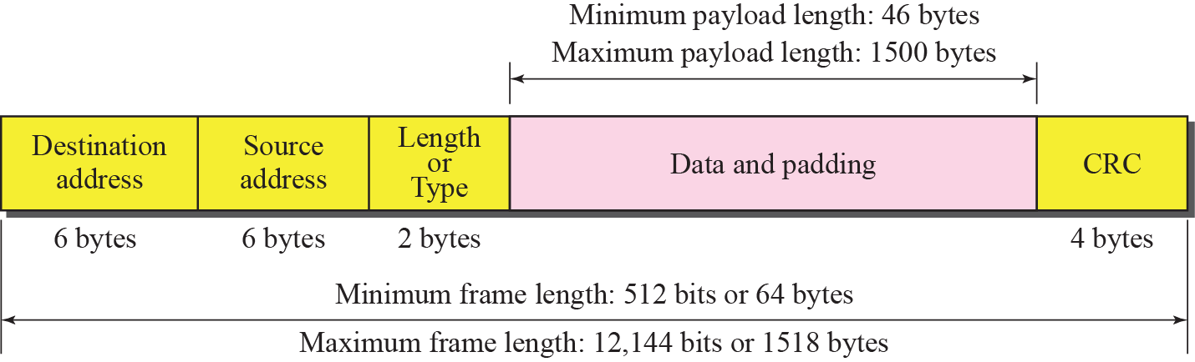
Frame Length
The Ethernet frame must have a minimum and maximum frame length

Slide 11
Frame Length (Cont.)
Why impose the minimum frame length restriction ?
Required for the operation of CSMA/CD
Introduced later
Why impose the Maximum frame length restriction ?
Memory was expensive when Ethernet was design
Helped to reduce the size of the buffer if maximum frame length is imposed
Prevent one station from monopolizing the shared medium

Slide 12
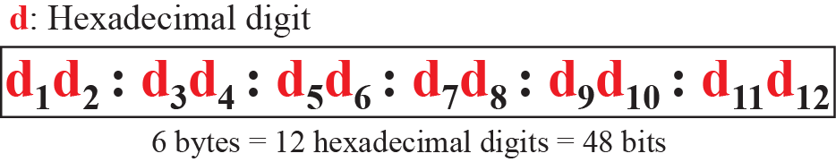
Addressing
Data link address = physical address = MAC address

Slide 13
Addressing (Cont.)
Source address is always unicast
Destination Address
Unicast
One single recipient
The least significant bit of the first byte in a destination address is 0
Multicast
A group of recipients
The least significant bit of the first byte in a destination address is 1
Broadcast: a special case of multicast
All stations connected to the LAN
48 1s

Slide 14
Unicast and Multicast Addresses

Slide 15
Example 3.1
Define the type of the following destination addresses:
a. 4A:30:10:21:10:1B
b. 47:20:1B:2E:08:EE
c. FF:FF:FF:FF:FF:FF
Solution
a. This is a unicast address because A in binary is 1010 (even).
b. This is a multicast address because 7 in binary is 0111 (odd).
c. This is a broadcast address because all digits are F’s.

Slide 16
Addressing (Cont.)
The way the addresses are sent out on the line
The transmission is left-to-right, byte by byte
However, for each byte, it is sent right-to left, bit by bit
Thus, the bit that defines an address as unicast or multicast arrives first at the receiver

Slide 17
Example 3.2:
Show how the address 47:20:1B:2E:08:EE is sent out on line
Solution:
Transform to binary:
Since the address is sent left-to-right, byte-by-byte; for each byte, it is sent right-to-left, bit by bit
01000111:00100000:00011011:00101110:11101110
← 11100010 00000100 11011000 01110100 00010000 01110111

Slide 18
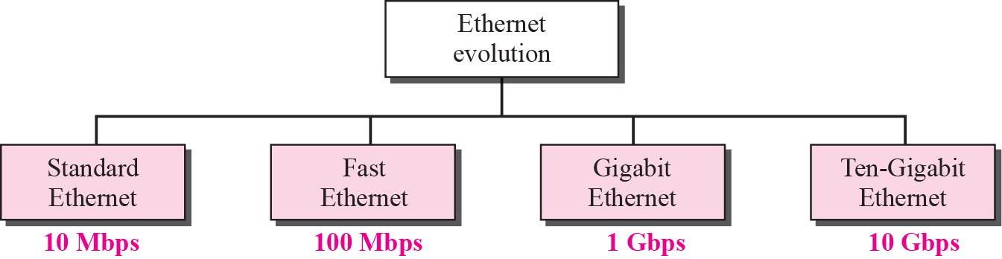
Ethernet Evolution
Designed in 1973 by Xerox
Four Generations
Standard Ethernet (10 Mbps)
Fast Ethernet (100 Mbps)
Gigabit Ethernet (1 Gbps)
Ten-Gigabit Ethernet (10 Gbps)

Slide 19
Standard Ethernet
Logical topology is a bus
Physical topology may be a bus or a star
The medium is shared between stations
Only one station at a time can use it
All stations receive a frame sent by a station
Only destination keeps it while the rest drop it
Access Method: CSMA/CD

Slide 20
Access Method: CSMA/CD
CSMA/CD: Carrier Sense Multiple Accesses with Collision Detection
CSMA:
Multiple access: every station has an equal right
Carrier sense: sense the medium before sending a frame.
Starting transmission if not data on the medium
“Sense before sending” or “listen before talk”
However, CSMA only reduce the possibility of collision, but it can not eliminate it.

Slide 21
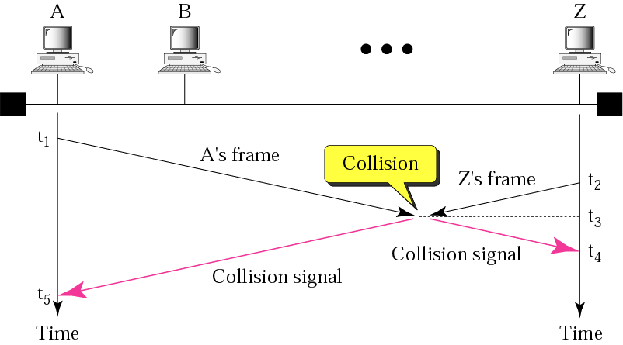
CSMA Problem
The McGraw-Hill Companies, Inc., 2000

Slide 22
Access Method: CSMA/CD
Collision Detection
Station must continue to listen after sending has begun (sending while listening)
If a collision
Send a jam signal to destroy the data
Wait for a random time and try again
In the next slide
t₁: A sense the medium and find it idle, so sends a frame
t₂: C sense the medium and find it idle, so sends a frame
t₃: C detects a collision and abort the transmission
t₄: A detects a collision and abort the transmission

Slide 23
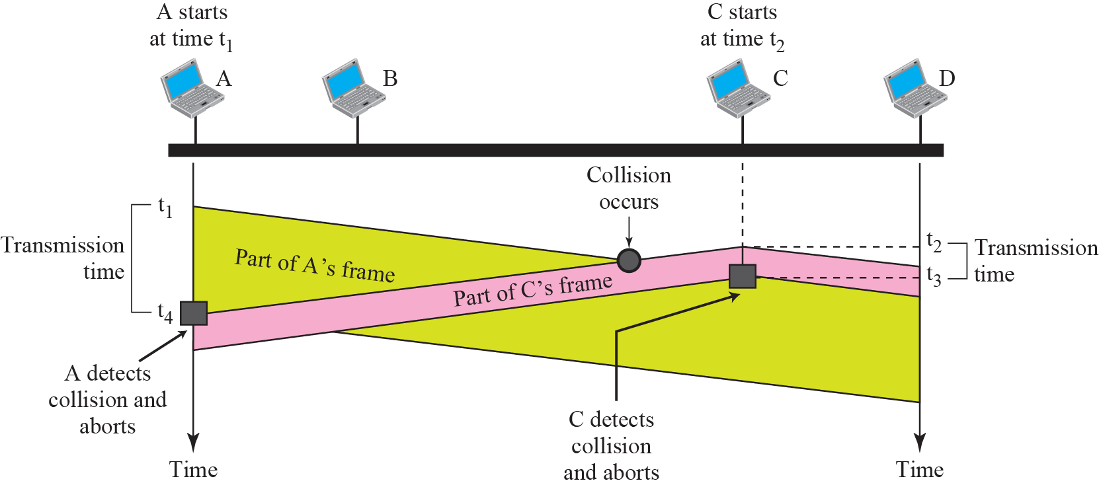
Collision of the First Bit in CSMA/CD

Slide 24
Minimum Frame Size
For CSMA/CD to work
We need a restriction on the frame size
The transmission time of a frame must be at least two times the maximum propagation time
Assume that worst-case that the two stations are the maximum distance apart

Slide 25
Example:
Assume that
The length of a 10BASE5 cable is 2500 meters
The data rate is 10 Mbps
Propagation speed is 200,000,000 meters/sec
Ignore any propagation delay in the connecting devices
Question 1: how long does it take for a bit to travel from the network distance ?
Answer:
2500 m / 200,000,000 meters/second = 12.5 microseconds

Slide 26
Example (Cont.):
Questions 2: find the maximum time it takes to sense a collision
Note:
The worst case occurs when data are sent from one end and collision happens at the other end
The signal needs to take a round-trip
Answer:
In the worst case, the collision would be sensed in 2 × 12.5 = 25 microseconds

Slide 27
Example (Cont.):
Questions 3: find the minimum size of a frame for collision detection to work properly
Answer:
Assume that x equal the minimum number of bits
X bits / 10M bits/second = 0.000025 seconds
X = 10,000,000 × 0.000025 = 250 bits = 31.25 bytes
The minimum frame size must be larger than 32 bytes for an Ethernet network of 2500 meters to work properly.
In fact, the minimum size is set to 512 bits to allow for propagation delay in the connecting devices.

Slide 28
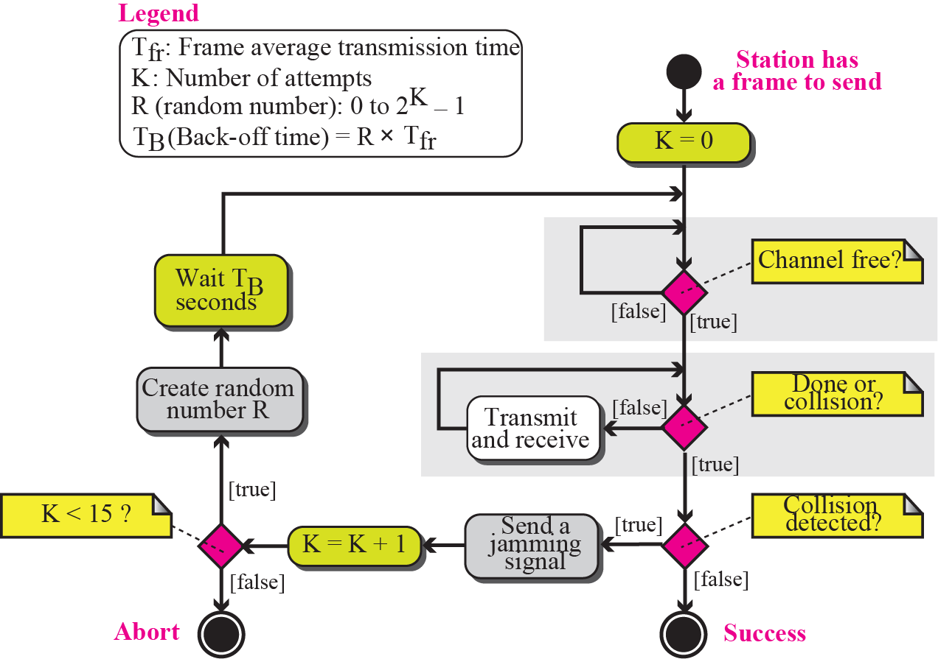
Procedure: CSMA/CD Flow Diagram

Slide 29
Fast Ethernet
Goal
Upgrade the data rate to 100 Mbps
Make it compatible with Standard Ethernet
Keep the same 48-bit address
Keep the same frame format
Keep the same minimum and maximum frame lengths

Slide 30
Fast Ethernet (Cont.)
Keep the MAC sub-layer untouched
However, drop the bus and keep only star topology
Two implementation choice for star topology
Half duplex: stations are connected via a hub
Use CSMA/CD
Full duplex: station are connected via a switch
Every station is connected by two separate paths to the hub
No collision and no need for CSMA/CD
But keep CSMA/CD for backward compatibility

Slide 31
Gigabit Ethernet
Goal
Upgrade the data rate to 1 Gbps
Make it compatible with Standard or Fast Ethernet
Keep the same 48-bit address
Keep the same frame format
Keep the same minimum and maximum frame lengths
To support auto-negotiation as defined in Fast Ethernet (Skip!)

Slide 32
Gigabit Ethernet (Cont.)
Also two modes
Full-Duplex Mode
Almost all implementations of Gigabit Ethernet uses this mode
No collision and CSMA/CD is not used
Thus, the maximum length of the cable is determined by the signal attenuation (衰減) of the cable
Not by the collision detection process
Half-Duplex Mode

Slide 33
Ten-Gigabit Ethernet
Goal
Upgrade the data rate to 10 Gbps
Make it compatible with Standard, Fast, and Gigabit Ethernet
Keep the same 48-bit address
Keep the same frame format
Keep the same minimum and maximum frame lengths
Allow the interconnection of existing LANs into a metropolitan area network (MAN) or a wide are network (WAN)
Make Ethernet compatible with technologies such as Frame Relay or ATM
Implementation
Operate only in full duplex mode

Slide 34
Outline
Wired Local Area Networks
Wireless LANs
Point-to-Point WANs
Switch WANs
Connecting Devices

Slide 35
IEEE 802.11 Wireless LANs
Sometimes called wireless Ethernet
Family
IEEE 802.11: 2 Mbps
2.40~2.48 GHz
IEEE 802.11b: 11 Mbps
2.40~2.48 GHz
IEEE 802.11a: 54 Mbps
5 GHz
IEEE 802.11g: 54 Mbps
2.40~2.48 GHz
IEEE 802.11n: 300 Mbps
2.4 or 5 GHz

Slide 36
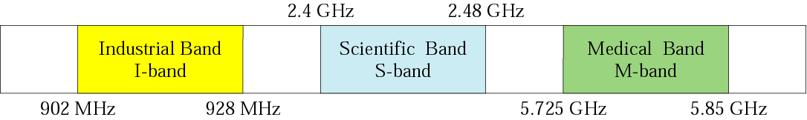
Figure 3-12
ISM Bands
ISM: Industrial, Scientific and Medical bands
Unlicensed band
The McGraw-Hill Companies, Inc., 2000

Slide 37
Architecture
Basic Service Set (BSS)
With an AP
Without an AP: independent BSS, also called ad hoc architecture
Extended Service Set (ESS)
Made of two or more BSSs with APs
BSSs are connected through a distribution system
Usually a wired LAN

Slide 38
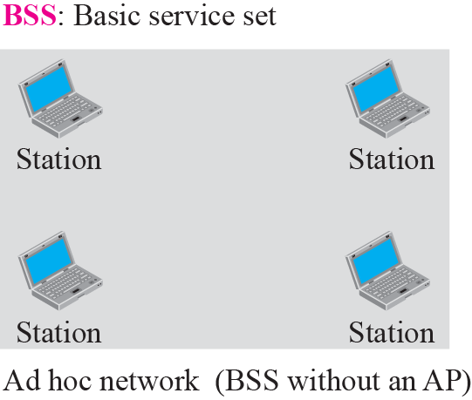
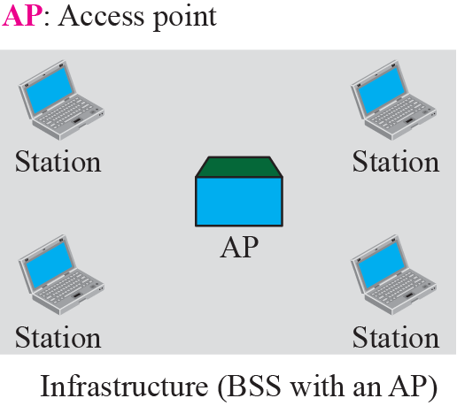
Figure 3-13
BSSs
The McGraw-Hill Companies, Inc., 2000

Slide 39
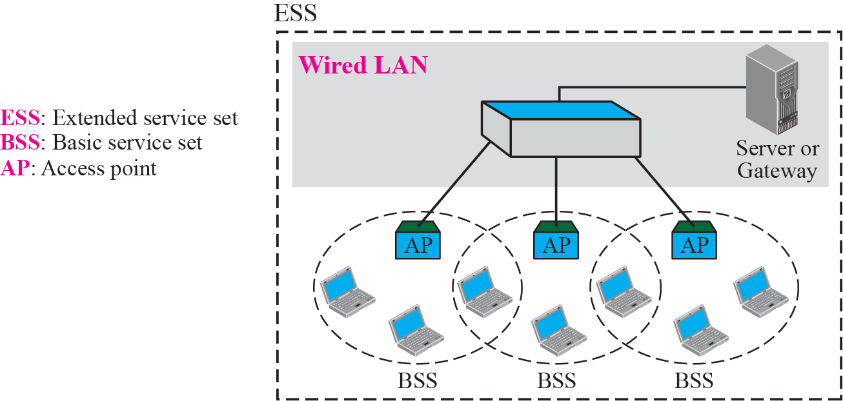
Figure 3-14
Extended Service Sets (ESSs)
The McGraw-Hill Companies, Inc., 2000

Slide 40
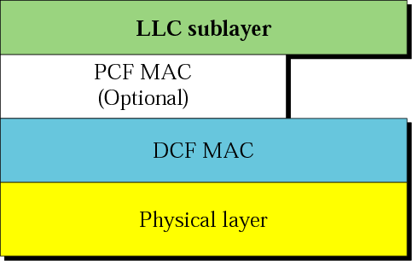
MAC Layer in IEEE 802.11
DCF (Distributed Coordination Function): CSMA/CA
PCF (Point Coordination Function): polling
Option

Slide 41
MAC Layer in IEEE 802.11 (Cont.)
Why not adopt CSMA/CD?
For collision detection, must send data and receive collision signals at the same time
Mean costly stations and increased bandwidth requirements
Collisions may not be detected due to hidden station problem
The distance between stations would be great
Signal fading in a large distance could prevent a station at one end from hearing a collision at the other end

Slide 42
CSMA/CA
Carrier Sense Multiple Access with Collision Avoidance: CSMA/CA
Cannot detect collision
Need ack. packet
However, Ethernet does not use ack. packet

Slide 43
Frame Exchange Time Line
References the next two slides
Sense the medium before sending a frame
If channel is idle, wait for a DIFS period and then sends a RTS (request to send) frame
After receiving the RTS and wait for a SIFS period
Destination node sends a CTS (clear to send) frame
Send the data after waiting SIFS period
Return an ACK after waiting SIFS period

Slide 44
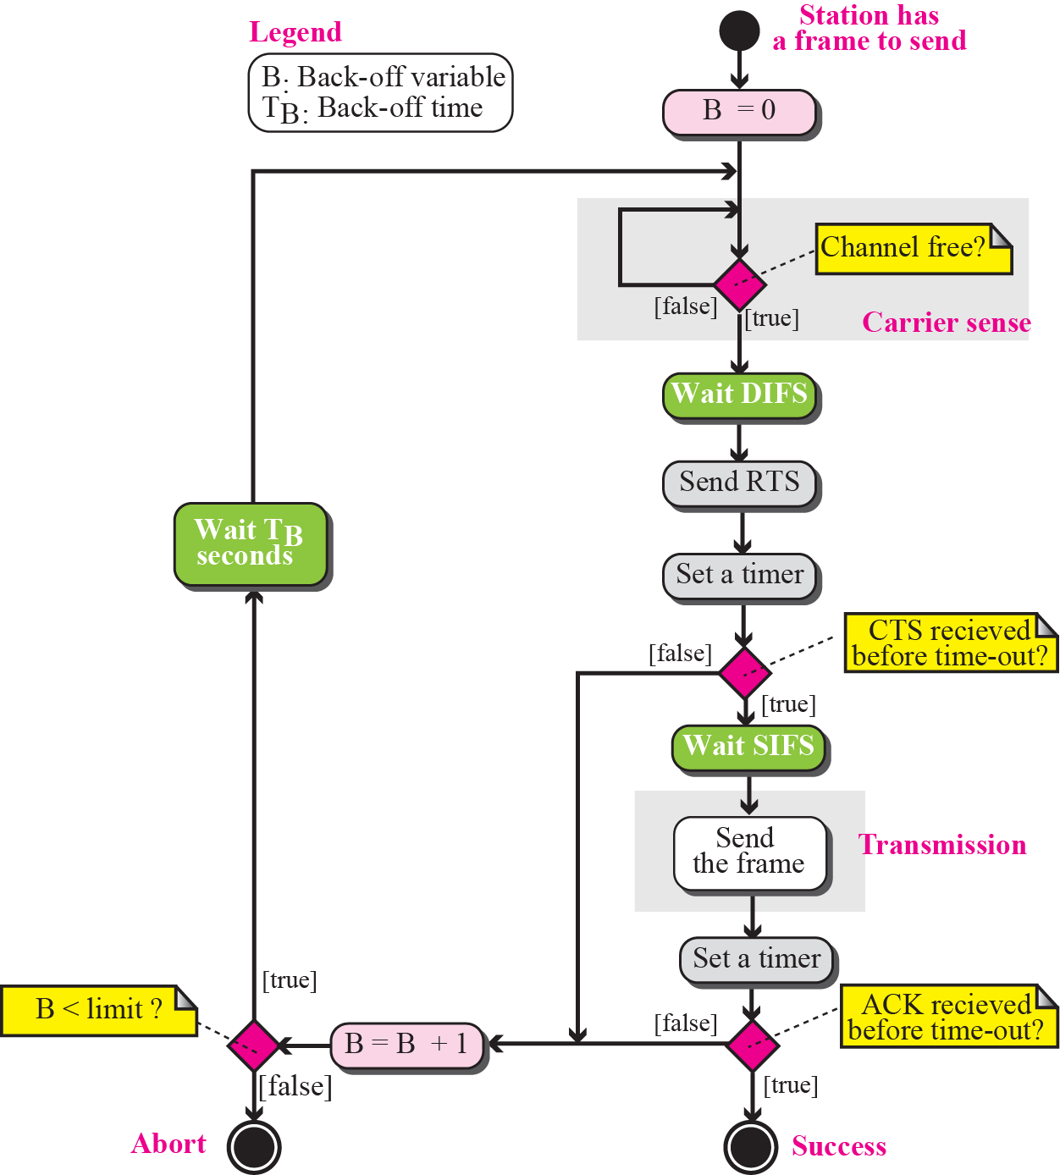
CSMA/CA Flow Diagram

Slide 45
CSMA/CA and NAV
S
o
u
r
c
e
D
e
s
t
i
n
a
t
i
o
n
A
l
l
o
t
h
e
r
s
t
a
t
i
o
n
s
•
•
•
T
i
m
e
T
i
m
e
T
i
m
e
T
i
m
e

Slide 46
DIFS and SIFS
SIFS (Short Interframe Space): 10 us in 802.11b
DIFS (DCF Interframe Space): 50 us in 802.11b
Why? Providing Priority Access
In the above slide
If another station want to send frame at the SIFS period between frame 1 and frame 2
It would find that there is no carrier and send its frame
Cause collision when frame 2 (CTS) is sent by destination
Thus, station must wait for DIFS
Thus, stations waiting for SIFS period has higher priorities than stations waiting for DIFS period

Slide 47
Network Allocation Vector
NAV: Network Allocation Vector
All of the RTS/CTS/DATA frames’ header contains a duration field.
Indicate the amount of time the sender needs to occupy the channel
When other stations received this frame
Start a timer, called NAV, that equals to the duration value
If NAV has not expired, other stations should not sense the medium and send the frame

Slide 48
CSMA/CA: Without RTS/CTS
DIFS
Src
Data
SIFS
Dest
Ack
DIFS
Other
CW
NAV
Defer Access
Backoff after Defer

Slide 49
CSMA/CA: With RTS/CTS
Src
RTS
Data
Dest
CTS
Ack
CW
Other
NAV
(RTS)
Next MPDU
NAV
(CTS)
Defer Access
NAV
(Data)
Backoff after Defer

Slide 50
Fragmentation
Fragmentation
Divide a large frame into smaller ones
Recommends fragmentation
Since the wireless channel is very noisy
Fragmentation is used to increase reliability
More efficient to resend a smaller frame than a large one

Slide 51
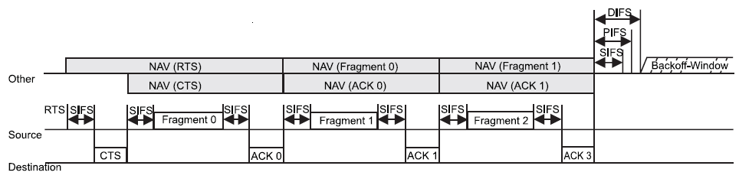
Fragmentation (Cont.)
Fragment Bursts which are individually acknowledged.
Retransmission is applied to each fragment

Slide 52
Frame Format
Frame control (FC): 2 bytes
Define the type of the frame and some control information
D: 2 bytes
Define the duration of the transmission
Addresses
Four addresses with each 6 bytes
Sequence control: 2 bytes
Define the sequence number of the frame
Frame body: 0~2312 bytes
Contain the information based on the type and the subtype defined in the FC field
FCS: 4 bytes
CRC-32 error detection sequence

Slide 53
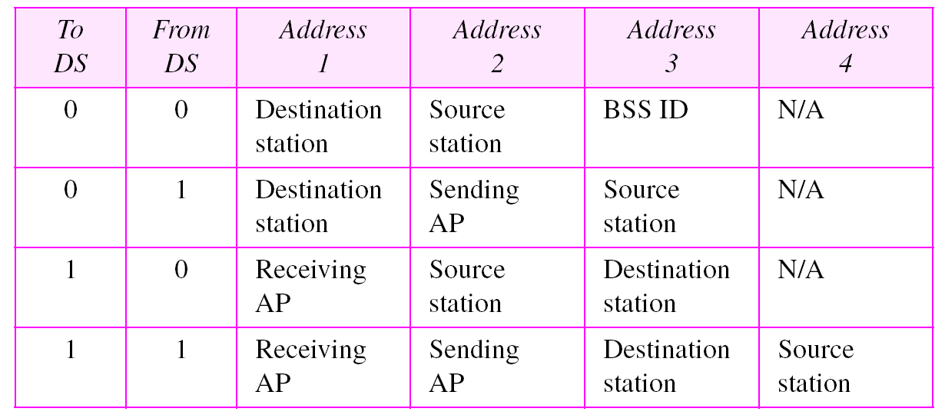
Addressing Mechanism
Address 1: always the address of the next device
Address 2: always the address of the previous device

Slide 54
Figure 3-14
Extended Service Sets (ESSs)
The McGraw-Hill Companies, Inc., 2000

Slide 55
Hidden and Exposed Station Problems
Hidden station problem
Solution: RTS (Request To Send) and CTS (Clear To Send)
Exposed station problem (Skip!)
A node is prevented from sending packets to other nodes due to a neighboring transmitter.
Cannot be solved by RTS/CTS

Slide 56
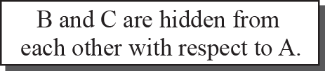
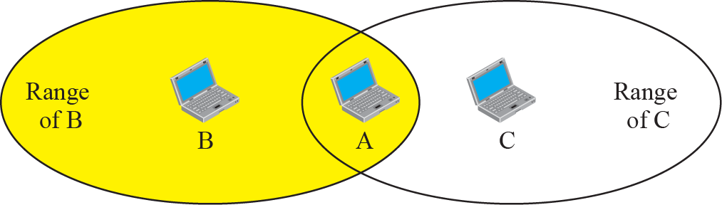
Hidden Station Problem

Slide 57
Use of Handshaking to Prevent Hidden Station Problem

Slide 58
Outline
Wired Local Area Networks
Wireless LANs
Point-to-Point WANs
Switch WANs
Connecting Devices

Slide 59
Point-to-Point WANs
Connect two devices using a line available from a public network such as a telephone network
Physical layer
V.90 (56K) Modem
Digital Subscriber Line (DSL)
Cable Modem
T lines: T1 and T3
SONET (Synchronous Optical Network)

Slide 60
Point-to-Point WANs (Cont.)
Data link layer
PPP: Point-to-Point Protocol
A way to encapsulate IP datagrams
A Link Control Protocol (LCP)
A family of Network Control Protocols (NCPs) specific to different network layer protocols
Link Control Protocol (LCP)
Network Control Protocol (NCP)
PPPoE

Slide 61
Outline
Wired Local Area Networks
Wireless LANs
Point-to-Point WANs
Switch WANs
Connecting Devices

Slide 62
Switched WANs
The backbone in the Internet are usually a switched WAN
A switched WAN is a wide area network that
Cover a large area ( a state or a country)
Provide access at several points to the user
Allow the connections of several inputs and outputs

Slide 63
Switched WANs (Cont.)
Differences between a switched WAN and LAN
Instead of a bus or star topology, switches are used to create multiple paths between two nodes
LAN technology is considered a connectionless but switched WAN is a connection-oriented technology
Three common switched WAN
X.25
Frame Relay
ATM

Slide 64
Outline
Wired Local Area Networks
Wireless LANs
Point-to-Point WANs
Switch WANs
Connecting Devices

Slide 65
Connecting Devices
The Internet is a combination of LANs and WANs
Joined by the connecting devices
Repeater and Hub: the first layer
Bridges: first two layers
Routers: first three layers
Switches
Sophisticated bridges or sophisticated routers

Slide 66
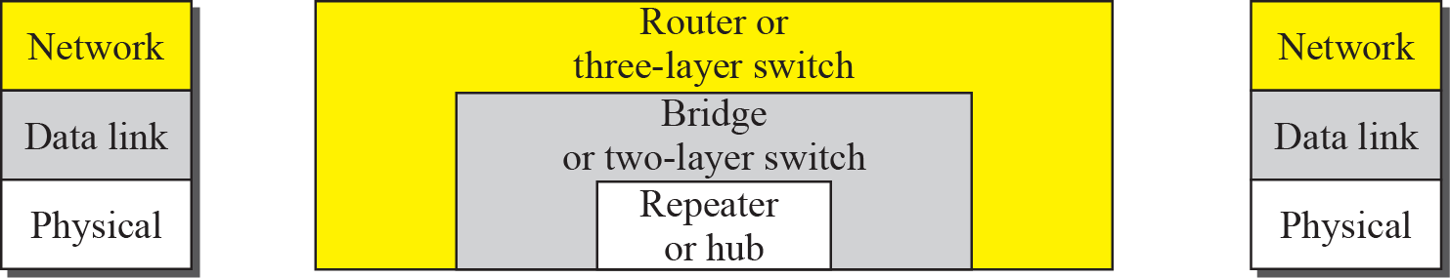
Connecting Devices
The McGraw-Hill Companies, Inc., 2000

Slide 67
Repeaters
Operate only in the physical layer
Receive a signal and regenerate the original bit pattern
Does not an amplifier
Amplifier does not discriminate between the intended signal and noise; just amplifies equally everything fed into it
Repeater regenerates the signal
If a weakened or corrupted signal, create a copy at the original strength
Can extend the physical length of a network
Connect two segments of the same LAN
The whole network is still one LAN

Slide 68
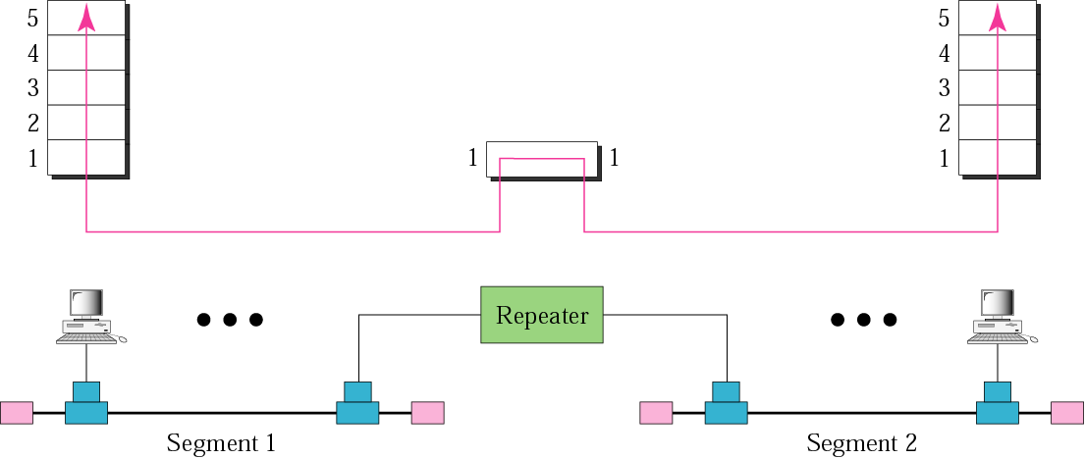
Figure 3-27
Repeater
The McGraw-Hill Companies, Inc., 2000

Slide 69
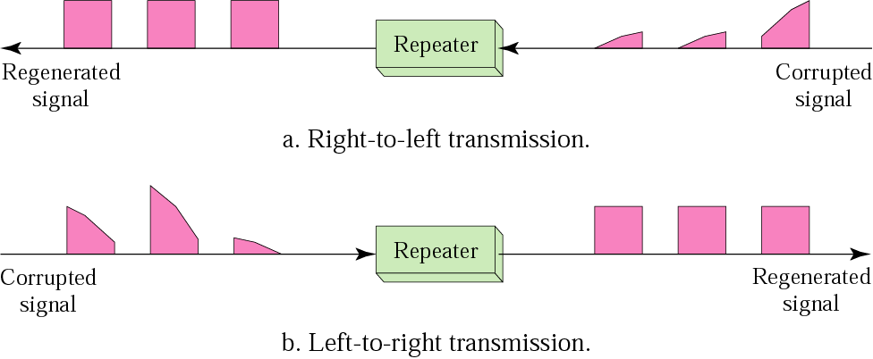
Function of a Repeater

Slide 70
Hubs
Operate only in the physical layer
A multi-port repeater
Create connections in a physical star topology
The whole network is still one single LAN
Packets sent by a station are received by every other station

Slide 71
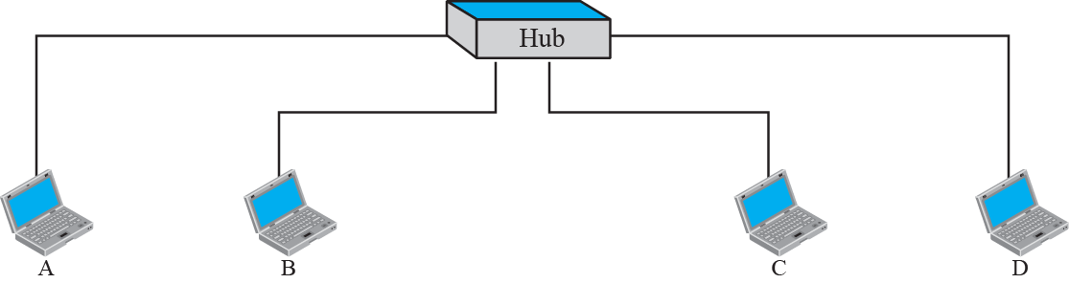
Figure 3-28
Hubs
The McGraw-Hill Companies, Inc., 2000

Slide 72

Note
A repeater or hub forwards every bit; it has no filtering capability.

Slide 73
Bridges
Operate in both the physical and the data link layer
Physical layer: regenerate the signal it receives
Data link layer: check the physical address
Has no physical address
Act only as a filter
All the segments connected by a bridge are still part of one LAN

Slide 74
Filtering Example
A LAN is divided into two segments separated by a bridge
If a packet destined for 712B13456142 arrives at port 1
Consult its table to find the departing interface

Slide 75
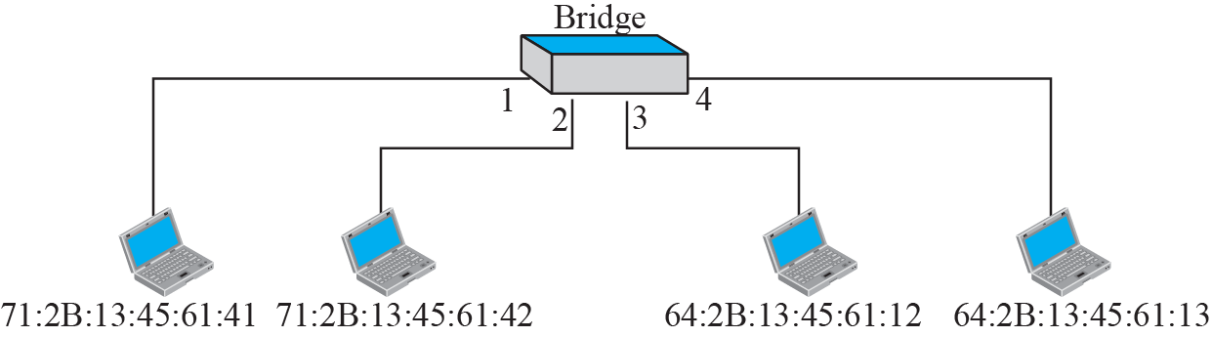
Bridge
The McGraw-Hill Companies, Inc., 2000

Slide 76
Transparent Bridges
Stations are completely unaware of its existence
If a bridge is added or deleted, reconfiguration of the stations is unnecessary
Criteria for a system equipped with a transparent bridge
Frames must be forwarded from one station to another
The forwarding table is automatically made by learning frame movement in the network
Loops in the system must be prevented
Also called a learning bridge
Learning: create the table mapping from the packets it receives
Source address and the arriving interface

Slide 77
Example: Learning Bridge
When station A sends a frame to station D
The bridge does not have an entry
The frame goes out from all three ports
From the source address and the incoming port
A must be connected to port 1
When station D sends a frame to station B
Flood the network again
Create the second entry for D
The learning process continues

Slide 78
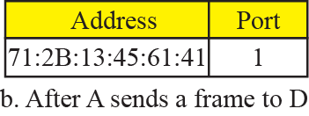
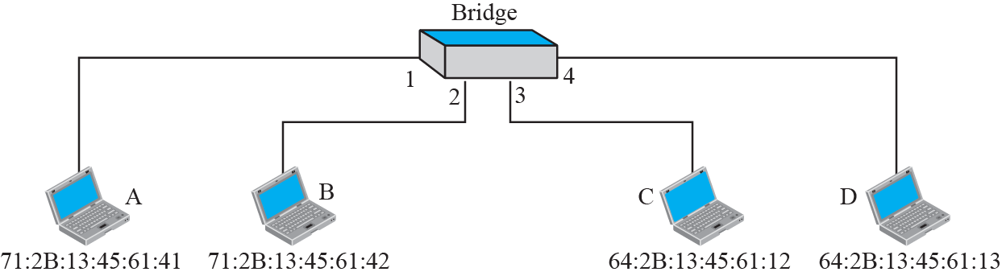
Example 1: Learning Bridge
M
M
M
M

Slide 79
Note
A bridge has a table used in filtering decisions.
A bridge does not change the physical (MAC) addresses in a frame.

Slide 80
Routers
A router is a three-layer devices
Physical layer: regenerate the signal it receives
Data link layer: check the physical address (source and destination) in the packet
Network: check the network address
A router is a internetworking device
Connect independent networks (LANs or WANs) to from an internetwork or an internet

Slide 81
Routers (Cont.)
Differences between a router and a repeater or a bridge
A router has a physical and IP address for each of its interfaces
Routers have addresses on two or more networks
A router acts only on those packets whose destination physical address matches the physical address of the incoming interface
A router changes the physical address of the packet when it forward the packet

Slide 82
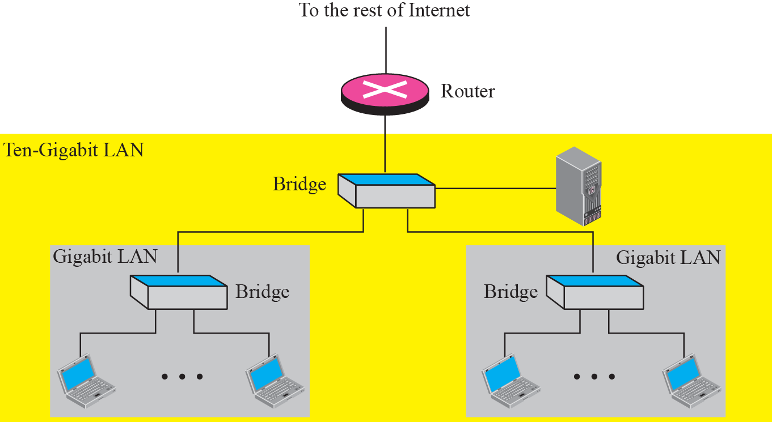
Figure 3-30
Routing Example
The McGraw-Hill Companies, Inc., 2000

Slide 83
Switches
Two different meaning
Two-layer switch
A bridge with many interface and a design that allow better performance
Three-layer switch
A router with an improved design to allow better performance

